Slide 1
FLOTRATION TECHNOLOGIES
CAST · Capillary Action Separation Technology
A modular water pretreatment unit
Proven pretreatment that extends the life of every treatment train.
An introduction to CAST water pretreatment
Chris Fetters, CEO / CTO · chris@flotration.com
For discussion purposes. Non-confidential overview; not a technical specification or an offer of terms.
Notes:
Thanks for the time. I'm Chris Fetters, CEO and CTO of Flotration. I brought two things to leave on the table: a scaled model and a working bench-scale unit. In the next 15 minutes I'll introduce CAST, show why it fits your water, and suggest a low-risk way to prove it — a paid pilot on your own stream.

Slide 2
WHY WE'RE HERE
FLOTRATION TECHNOLOGIES
CAST in one minute
CAST removes the fine suspended solids, oils, and organics that make challenging source water and treated effluent hard to clarify and expensive to reuse. It installs ahead of your existing treatment, is delivered as a service, and is proven first in a paid on-site pilot.
1
2
3
Who we are
What CAST is
On the table today
Flotration Technologies — an early-stage water treatment company with active paid pilots in municipal and industrial settings.
A modular pretreatment unit, delivered on a lease-plus-usage basis. Units only, field-deployable, scalable.
A scaled model and a working bench-scale unit you can run your own water through.
Flotration Technologies · Non-confidential overview · Not a technical specification or an offer of terms.
2
Notes:
Lead with the punchline so nothing depends on me finishing. CAST is a pretreatment unit that sits in front of whatever you already run; it comes as a service so there's no big capital ask; and we always prove it on a pilot first.

Slide 3
THE PROBLEM
FLOTRATION TECHNOLOGIES
The water problems CAST is built for
Common across municipal, industrial, energy, and federal water. Actual chemistry is confirmed in a pilot.
1
Contaminants that resist treatment
PFAS, fine suspended solids, oils, organics, and metals overload conventional processes and foul the media and membranes behind them.
2
Sources under growing stress
Drought, saline intrusion, and declining source quality force more water to be recovered from harder, more variable feeds.
3
Discharge limits are tightening
Rising limits on PFAS, TSS, oil & grease, and metals, alongside growing expectations for reuse and freshwater reduction.
4
Treatment is expensive to run
Media replacement, membrane fouling, chemical dosing, and disposal are the recurring costs pretreatment is built to cut.
Flotration Technologies · Non-confidential overview · Not a technical specification or an offer of terms.
3
Notes:
I won't pretend I know your exact water yet — that's what a pilot tells us. But the water CAST is built for has a common signature: PFAS, fine and colloidal suspended solids, oils, organics, and metals that resist conventional treatment. The hard part is usually that this fouling load wrecks downstream equipment and stalls recovery and reuse.

Slide 4
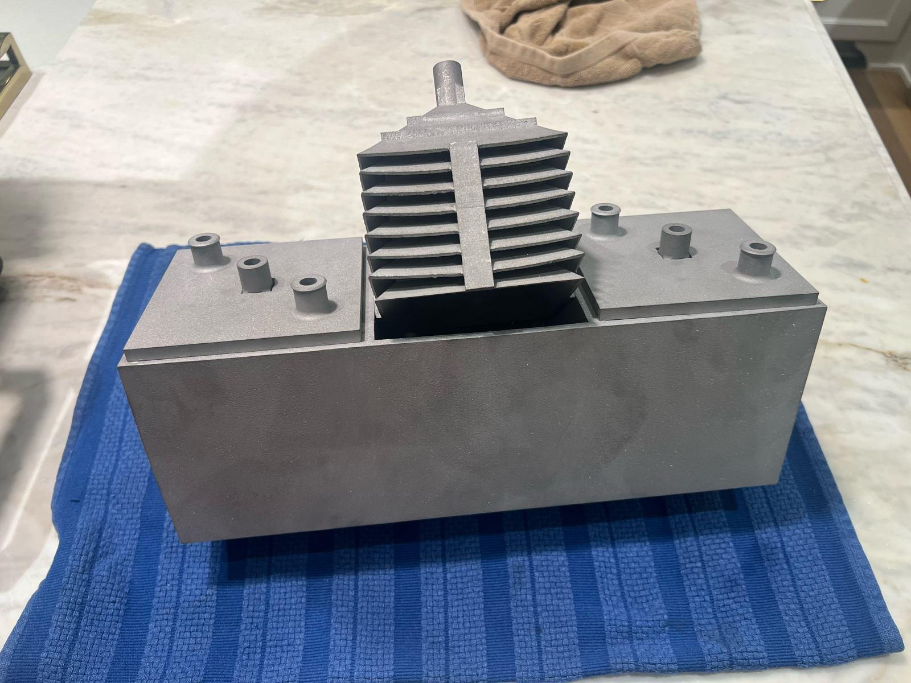
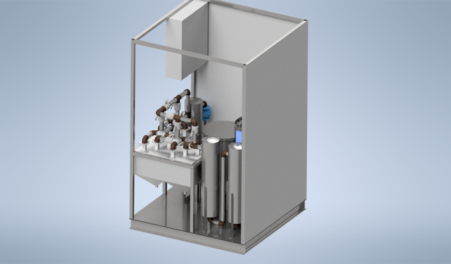
WHAT CAST IS
FLOTRATION TECHNOLOGIES
A pretreatment unit, delivered as a service
The CAST unit
Capillary vessels, selective ion exchange, and integrated controls in a single skid.
1. A pretreatment unit
Installs ahead of your existing or planned treatment — clarifiers, flotation, RO, ion exchange, or membranes — and improves the performance and economics of whatever sits behind it.
2. Units only, modular
Field-deployable skids. Scale by adding capacity for phased or distributed needs. No fixed one-size package — the train is matched to your water.
3. Delivered as a service
A lease-plus-usage model that shifts spending from capital budget to operating budget. Rapid to deploy, easy to pilot.
CAST = Capillary Action Separation Technology
Flotration Technologies · Non-confidential overview · Not a technical specification or an offer of terms.
4
Notes:
Three things to hold onto. One, it's pretreatment — it makes your existing plant work better rather than replacing it. Two, it's a unit — modular skids you add as you grow. Three, it's a service — so it lands on the operating budget, not a big capital request. That is a photo of the actual scaled model.

Slide 5
HOW IT WORKS
FLOTRATION TECHNOLOGIES
A treatment train matched to your water
Not a fixed package. Low energy in, fouling precursors out, target contaminants captured, quality verified.
STEP 1
STEP 2
STEP 3
STEP 4
Capillary separation
Selective ion exchange
Optional GAC polishing
Integrated sensors + software
Hydrophilic waveguide vessels coalesce and lift fine hydrophobic particles, oils, and organics at low energy — removing the fouling precursors first.
Anion resins capture negatively charged organics; cation resins capture metals. Media are selected for your specific water chemistry.
A granular activated carbon stage trims residual organics to hit the target effluent quality.
Flow, pressure, breakthrough, and effluent quality are monitored across the train for adaptive, low-touch operation.
Flotration Technologies · Non-confidential overview · Not a technical specification or an offer of terms.
5
Notes:
The order matters. We take the fouling stuff out first with capillary separation, at low energy — no high-pressure membranes up front. Then selective resins grab the specific contaminants that matter for your permit. Optional carbon polish at the end. The whole train is instrumented so it runs low-touch.

Slide 6
THE FIT
FLOTRATION TECHNOLOGIES
Why CAST fits challenging water
THE CHALLENGE
CAST RESPONSE
Fine suspended solids and colloids that resist settling
→
Coalesces and removes 90–99% of suspended solids; turbidity to ~1–3 NTU
Oils and grease
→
Over 90% removal when present
Colloidal / hydrophobic organic load (COD)
→
30–60% reduction of the hydrophobic fraction
Membrane fouling and low RO recovery
→
Removes fouling precursors; SDI₁₅ below 3; lifts downstream recovery
Sludge volume and chemical dosing
→
Drier sludge; 10–20% less coagulant than conventional flotation
Expected ranges — site-specific and confirmed per matrix in a pilot. Dissolved salts pass through and are addressed downstream.
Flotration Technologies · Non-confidential overview · Not a technical specification or an offer of terms.
6
Notes:
This is the slide that matters. Left column is the water challenge, right column is what CAST does about it. The headline is fouling: we pull out the fine and colloidal solids, oils, and organics that wreck membranes and centrifuges — which is exactly what lets you recover and reuse water.

Slide 7
THE NUMBERS
FLOTRATION TECHNOLOGIES
Expected performance envelope
90–99%
1–3 NTU
>90%
30–60%
50–75%
TSS removed
turbidity
oil & grease removed
COD reduction
brine volume cut*
THE COMPOUNDING WIN
Cleaner feed lets high-recovery RO push overall water recovery from roughly 75–80% toward 90–95% — shrinking brine, disposal cost, and freshwater draw at the same time.
*With downstream high-recovery or closed-circuit RO. All values are expected, bench- and pilot-based ranges; site-specific.
Flotration Technologies · Non-confidential overview · Not a technical specification or an offer of terms.
7
Notes:
A few numbers to anchor the value, all expected ranges we confirm on a pilot. The single most valuable one for you is water recovery: by cleaning the feed, high-recovery RO behind us can take total recovery from the high-70s toward the low-90s. That cuts brine, cuts disposal, and cuts freshwater draw at once.

Slide 8
PROOF
FLOTRATION TECHNOLOGIES
What we can already show
8×
Independent third-party bench testing
In independent bench-scale column testing, adding CAST ahead of ion exchange extended run length by more than eight times before breakthrough and measurably reduced column fouling. Longer runs cut media replacement — the single largest recurring cost.
Protected technology
Real pilots underway
United States non-provisional and Patent Cooperation Treaty (PCT) applications filed February 19, 2026.
Paid pilots are running now across municipal and industrial settings, with third-party performance testing completed.
Proof of the fouling and run-length mechanism that also drives water recovery.
Flotration Technologies · Non-confidential overview · Not a technical specification or an offer of terms.
8
Notes:
Two credibility points. First, the mechanism is independently validated: in third-party bench testing, putting CAST in front of ion exchange ran more than eight times longer before breakthrough and fouled less. That same fouling reduction is what unlocks water recovery for you. Second, this isn't vaporware — patents filed and paid pilots running now.

Slide 9
THE MODEL
FLOTRATION TECHNOLOGIES
A low-risk way to adopt it
01
02
03
Water as a service
Pilot first
Modular and scalable
Lease-plus-usage, not a capital purchase. Spending moves to the operating budget.
We prove CAST on your actual water before any scale commitment is made.
Start with one unit; add capacity as results justify. Phased or distributed as needed.
You are not buying a plant. You are testing a unit on one stream — with the numbers to justify each next step.
Flotration Technologies · Non-confidential overview · Not a technical specification or an offer of terms.
9
Notes:
The commercial model is built to remove risk. It's a service, so no capital line. We always pilot first on your water. And it's modular, so you scale only as the results earn it. You're testing a unit on one stream, not committing to a plant.

Slide 10
NEXT STEPS
FLOTRATION TECHNOLOGIES
A suggested path from here
1
Share the water data
Two to three weeks of characterization on a target stream: flow, TSS, turbidity, COD, oil & grease, and metals.
2
60-minute scoping call
Define pilot goals, tie-in points, and the sampling plan on your target stream.
3
One-page ROI
Built from your current disposal, discharge, and chemical costs.
4
Paid on-site pilot
Run CAST on the real stream; document removal, breakthrough, and recovery curves.
Flotration Technologies · Non-confidential overview · Not a technical specification or an offer of terms.
10
Notes:
If today goes well, here's the low-effort path. You send us a couple weeks of water data. We do a short scoping call and hand you a one-page ROI on your numbers. Then we run a paid pilot on your actual stream. Every step is small and gives you data before the next one.

Slide 11
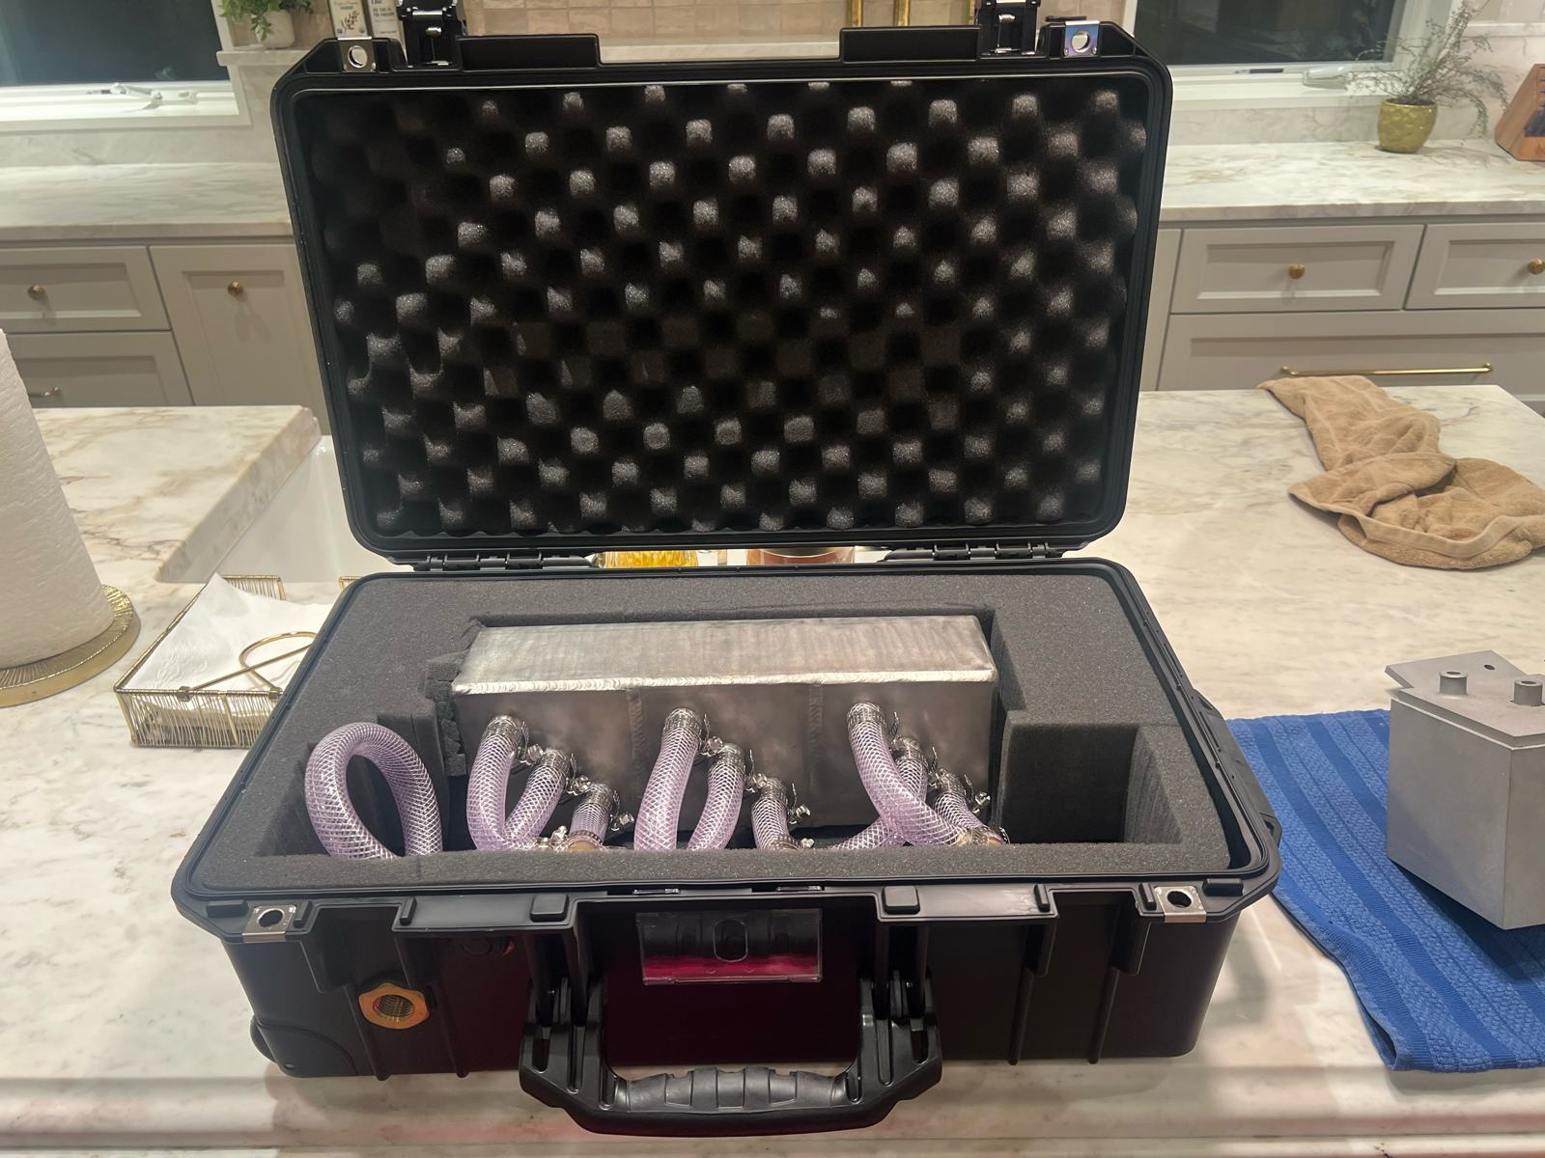
SEE IT RUN
FLOTRATION TECHNOLOGIES
On the table today
The unit, in your hands
A scaled model
See the CAST architecture and flow path in the hand — vessel geometry, the treatment train, and how the skid fits together.
A working bench-scale unit
Run your toughest stream through it and watch the separation happen in real time.
The best next step is your water in our unit. Pick a stream and let's sample it.
Flotration Technologies · Non-confidential overview · Not a technical specification or an offer of terms.
11
Notes:
This is the invitation. I didn't just bring slides — I brought a scaled model and a working bench unit. Point me at your hardest water and let's run it. The fastest way to settle any question in this deck is to watch your own stream separate in the unit.

Slide 12
FLOTRATION TECHNOLOGIES
Let's put CAST on your water.
Proven pretreatment that extends the life of every treatment train.
Chris Fetters, CEO / CTO · chris@flotration.com
John Michaels, COO · john@flotration.com
Non-confidential overview. Not a technical specification or an offer of terms. Performance ranges are expected and site-specific, confirmed in pilot.
Notes:
Thank you. The ask is simple: give me one stream and a couple weeks of data, and we'll show you what CAST does on your actual water.

Slide 13
THE MARKETS
FLOTRATION TECHNOLOGIES
One pretreatment platform, four markets
CAST installs ahead of existing treatment in each — the train is matched to the water.
1
Municipal & public water
PFAS removal, RO and membrane pretreatment, and recovery of solids-laden or declining source water for public systems.
2
Federal & defense
PFAS treatment at Department of Defense and federal facilities subject to Superfund and drinking-water requirements.
3
Oil & gas produced water
Produced- and flowback-water treatment and reuse — cutting disposal volume and enabling recycling.
4
Industrial & manufacturing
Process and cooling water, RO-reject recovery, metals capture, and discharge reduction. Landfill leachate is a further fit.
Flotration Technologies · Non-confidential overview · Not a technical specification or an offer of terms.
13
Notes:
One platform, four markets. The point is that CAST is the same pretreatment step whether the client is a municipality, a federal or defense site, an oil & gas operator, or an industrial plant — the train is matched to the water, not the market.

Slide 14
WHY NOW
FLOTRATION TECHNOLOGIES
The market is moving toward pretreatment
Regulation and reuse economics are pulling demand into CAST’s space. Figures are third-party market estimates.
1
PFAS regulation in force
EPA has set enforceable drinking-water limits for PFOA and PFOS and designated them hazardous under Superfund. Compliance timelines are being finalized; demand is durable across public water, states, and DoD.
2
A growing PFAS-treatment market
Independent estimates put PFAS treatment near $2–3 billion in 2025, growing at a high-single-digit or greater annual rate into the early 2030s.
3
Produced water at scale
Produced-water treatment is an $8–9 billion market today, projected toward roughly $13–14 billion by 2030 as reuse and recycling expand.
4
Consolidation favors platforms
Recent water-sector consolidation shows appetite for scaled treatment platforms — and CAST is additive to systems those players already deploy.
Flotration Technologies · Non-confidential overview · Not a technical specification or an offer of terms.
14
Notes:
Why now. PFAS limits are in force and reuse economics are improving, so demand is moving toward exactly the pretreatment step CAST provides. The market figures are third-party estimates, used only to size the opportunity — not our numbers.

Slide 15
REFERENCE / LEAVE-BEHIND
FLOTRATION TECHNOLOGIES
Units, acronyms & background
UNITS & ACRONYMS
ABOUT FLOTRATION TECHNOLOGIES
CAST
Capillary Action Separation Technology — Flotration's pretreatment train
The company
TSS
Total Suspended Solids — undissolved particulate load (mg/L)
An early-stage water-treatment company. CAST pretreatment units are in active deployment readiness, with paid pilots underway across municipal and industrial settings.
NTU
Nephelometric Turbidity Unit — water cloudiness / clarity
COD
Chemical Oxygen Demand — organic load in water (mg/L)
Markets served
Municipal and public water including PFAS, federal and defense, oil & gas produced water, and industrial and manufacturing — with landfill leachate a further fit.
O&G
Oil & Grease — hydrocarbon content (mg/L)
RO
Reverse Osmosis — membrane desalination / concentration
IX
Ion Exchange — resin capture of ions (anion=organics, cation=metals)
What CAST does
GAC
Granular Activated Carbon — adsorption polishing stage
Installs ahead of existing or planned treatment — clarifiers, flotation, RO, ion exchange, or membranes — and improves the performance and economics of whatever sits behind it.
SDI₁₅
Silt Density Index (15-min) — membrane-fouling potential of feed water
Proof & protection
NPDES
National Pollutant Discharge Elimination System — federal discharge permit
Independent third-party bench testing extended run length more than eightfold before breakthrough. Protected by U.S. non-provisional and PCT patent applications filed February 19, 2026.
PCT
Patent Cooperation Treaty — international patent filing route
PFAS
Per- and polyfluoroalkyl substances — regulated “forever chemicals”
TDS
Total Dissolved Solids — dissolved salts and minerals (mg/L)
mg/L
milligrams per litre ≈ parts per million (ppm)
Flotration Technologies · Non-confidential overview · Not a technical specification or an offer of terms.
15
Notes:
SPEAKER / LEAVE-BEHIND REFERENCE — not for projection.
UNITS & ACRONYMS
• CAST — Capillary Action Separation Technology: Flotration's modular pretreatment train (capillary separation + selective ion exchange + optional GAC + integrated controls).
• PFAS — per- and polyfluoroalkyl substances: regulated 'forever chemicals'.
• TSS — Total Suspended Solids (mg/L): undissolved particulate load.
• NTU — Nephelometric Turbidity Unit: optical cloudiness; lower = clearer.
• COD — Chemical Oxygen Demand (mg/L): proxy for organic load.
• O&G — Oil & Grease (mg/L): hydrocarbon content.
• TDS — Total Dissolved Solids (mg/L): dissolved salts and minerals.
• RO — Reverse Osmosis: membrane that concentrates dissolved salts; 'recovery' = fraction of feed turned into clean permeate.
• IX — Ion Exchange: resin beds; anion resin grabs charged organics, cation resin grabs metals.
• GAC — Granular Activated Carbon: adsorption media used as a final organic polish.
• SDI15 — Silt Density Index (15-minute): how badly a feed will foul an RO membrane; below ~3 is good feed.
• NPDES — National Pollutant Discharge Elimination System: federal discharge permit program.
• PCT — Patent Cooperation Treaty: single international patent-application route.
ABOUT FLOTRATION
Flotration Technologies is an early-stage water-treatment company. CAST is its modular pretreatment unit, delivered as a service and proven on the client's own water in a paid pilot. Independent third-party bench testing extended downstream ion-exchange run length more than eightfold before breakthrough; U.S. non-provisional and PCT patent applications were filed February 19, 2026; paid pilots are underway across municipal and industrial settings.

